Slide 1
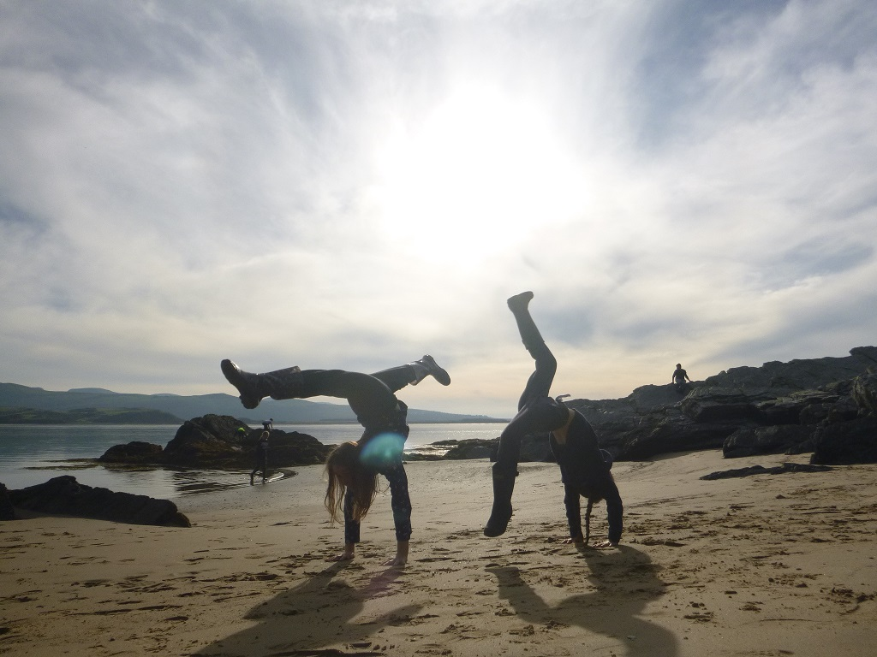
PLAS GWYNANT OUTDOOR EDUCATION CENTRE
{enter your date}

Slide 2
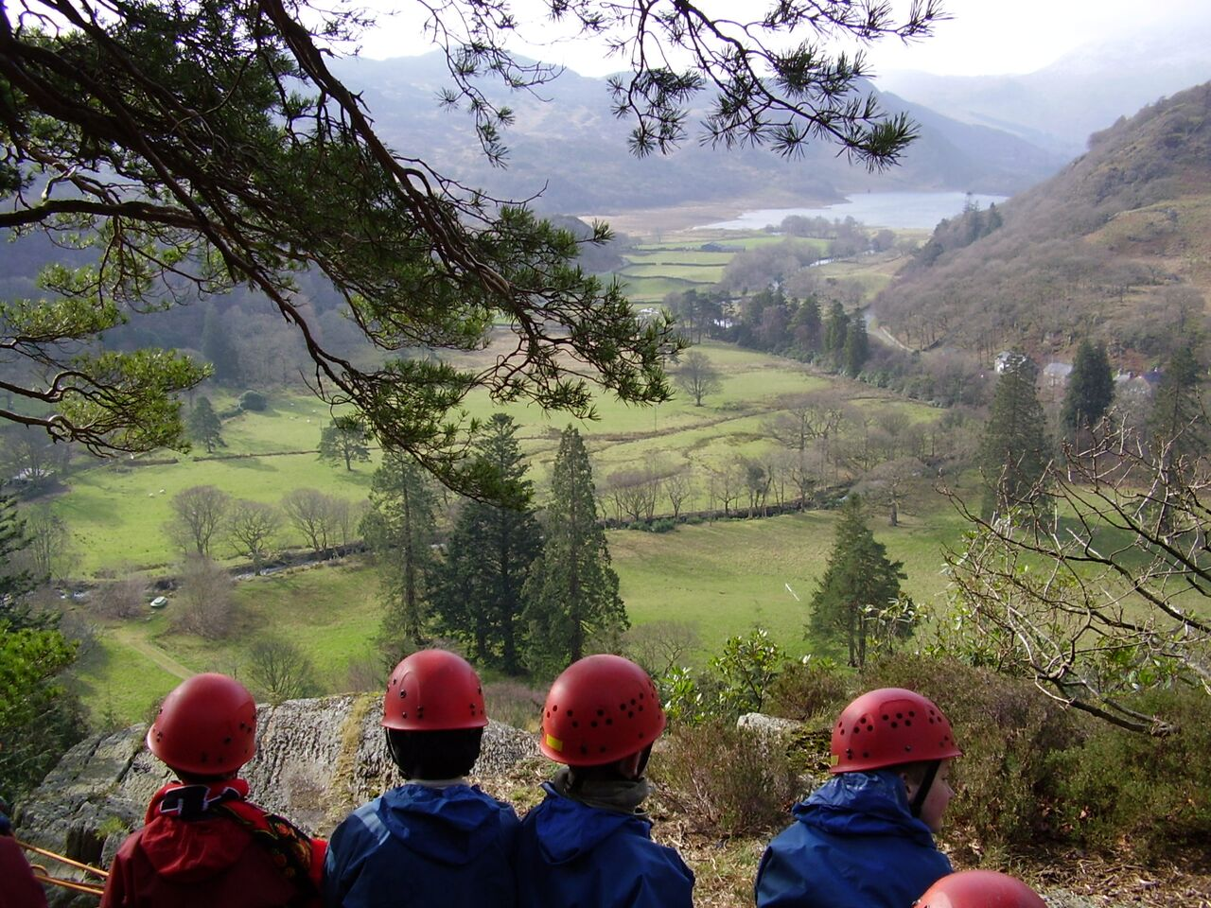
AGENDA
About Sandwell Residential Education Service
Your centre: Plas Gwynant
Activities and learning
Teacher & participant feedback
The benefits of residential experiences
Sleeping & eating
Q & A

Slide 3
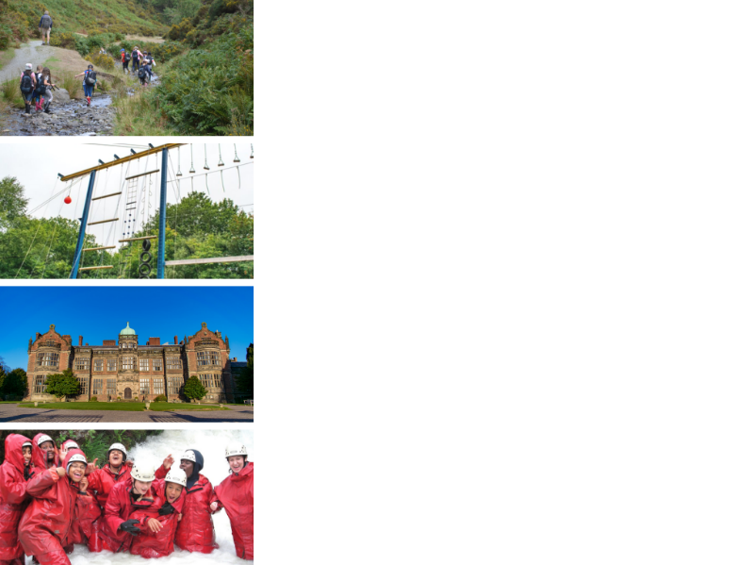
ABOUT SANDWELL RESIDENTIAL SERVICE
4 SUPER VENUES
Edgmond Hall Shropshire
Frank Chapman Centre Wyre Forest
Ingestre Arts Staffordshire
Plas Gwynant Snowdonia
HOME FROM HOME
Small, welcoming centres. Have the place to yourselves!
TAILORED PROGRAMMES
A real learning experience:
The programme is designed with school.
THE HIGHEST STANDARDS
14,000 pax p/a from across the UK

Slide 4
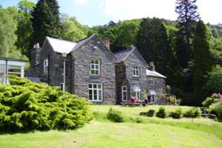
PLAS GWYNANT: CENTRE FACTS
Location
A beautiful lodge set in its own parkland at the foot of Snowdon.
Nant Gwynant, Caernarfon, LL55 4NR
Outside
Lots of safe space to play in grounds, and direct access to the mountains, rivers, lakes and beaches of the National Park.
54 beds
Dorms of 2 to 8
Groups of 40+ have sole occupancy
Inside
Comfortable social space, review rooms, and games room for a perfect residential stay.

Slide 5
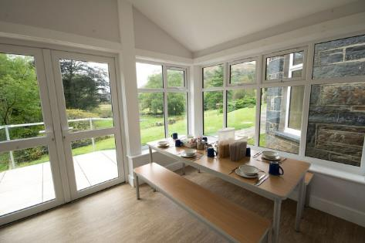
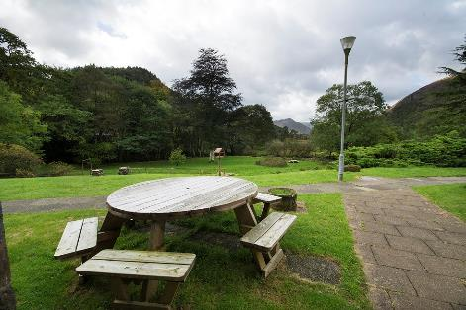
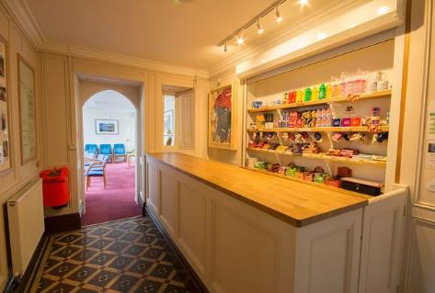
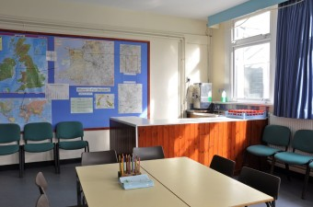
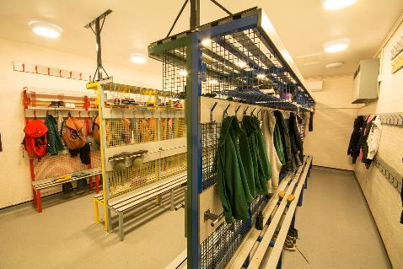
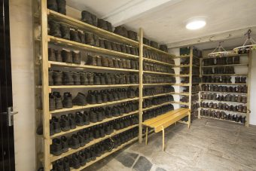
PLAS GWYNANT

Slide 6
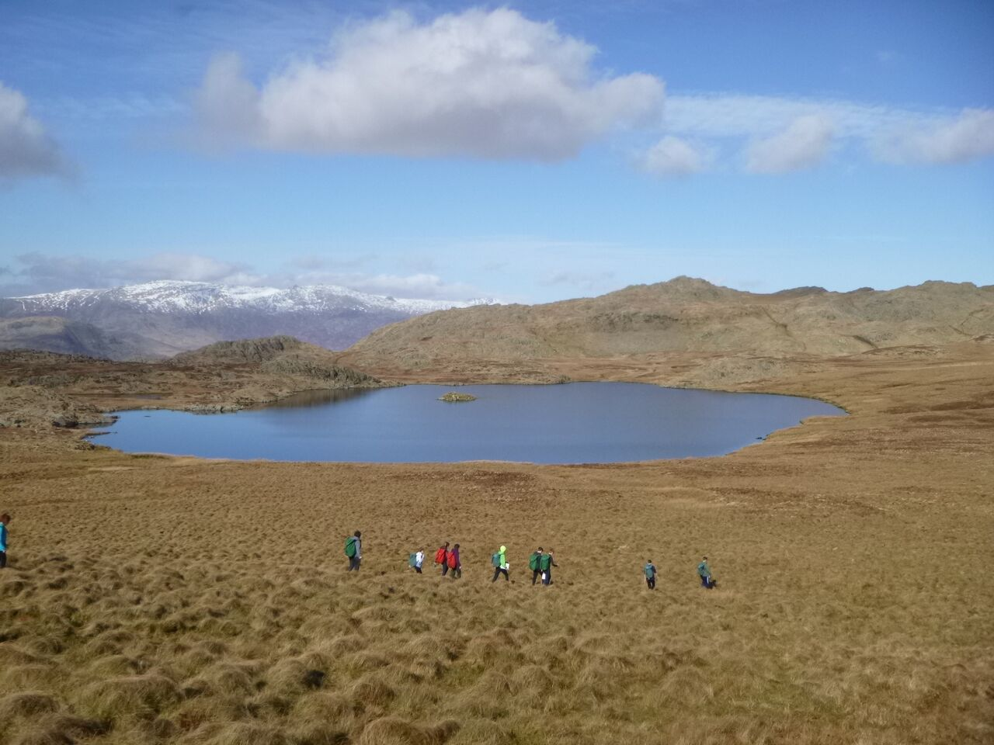
Notes:
Place: the more you immerse a young person – the more memorable it is, the more impactful the experience

Slide 7
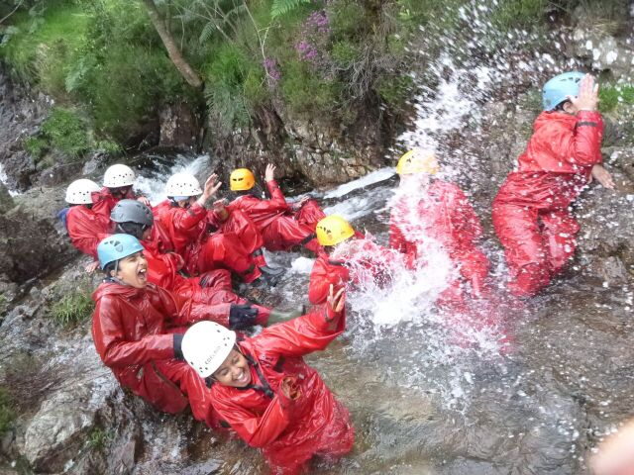
Notes:
Learning through experiences

Slide 8
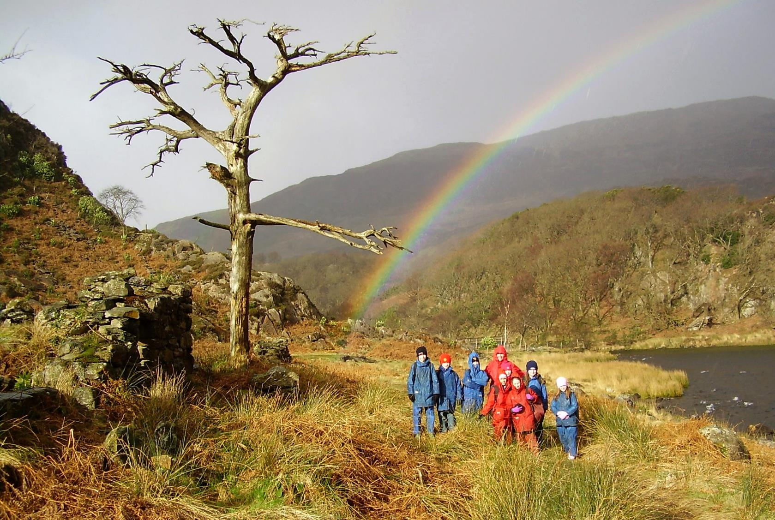
Notes:
Memorable

Slide 9
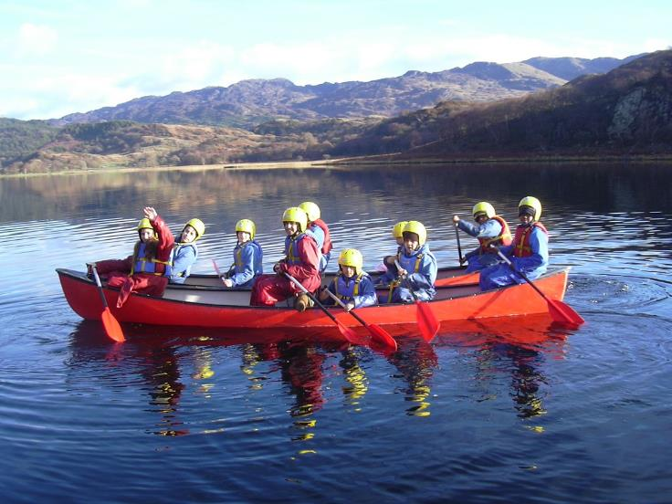
ACTIVITIES
At Plas Gwynant we offer an exciting range of adventurous outdoor activities that make the best use of the surrounding environment.
Tailored to the individuals, activities are all about challenging yourself, trying something new, and learning through experiences.
Activities include:
Rock Climbing
Abseiling
Gorge Walking
Kayaking
Raft Building
Environmental Based Activities
Mountain Biking
Orienteering

Slide 10
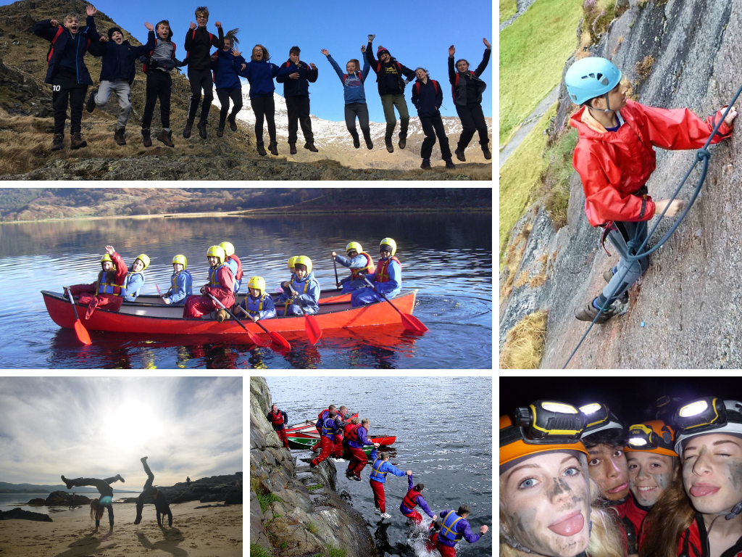

Slide 11
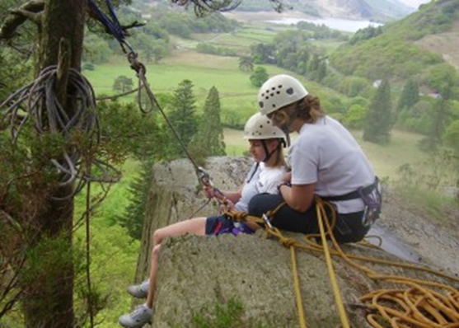
LEARNING
The Plas Gwynant team have technical skill to deliver adventurous experience and, crucially, the soft skills to help every young person achieve more than they ever expected.
We are specialists in residential experiences, and know how valuable it can be.
Tailored Programmes
Every visit is unique. The team work with school and the pupils to shape an exciting, fun, and valuable visit to Plas Gwynant
Group sizes are 12 students to 1+ Plas Gwynant tutor supported by school staff.

Slide 12
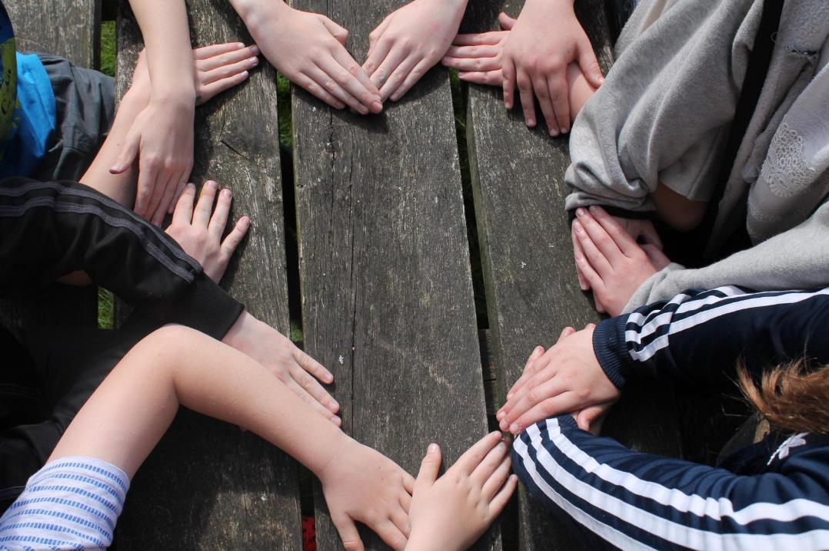
To watch my students transform before my eyes into a new version of themselves - that was amazing!
Assistant Headteacher - Sandwell

Slide 13
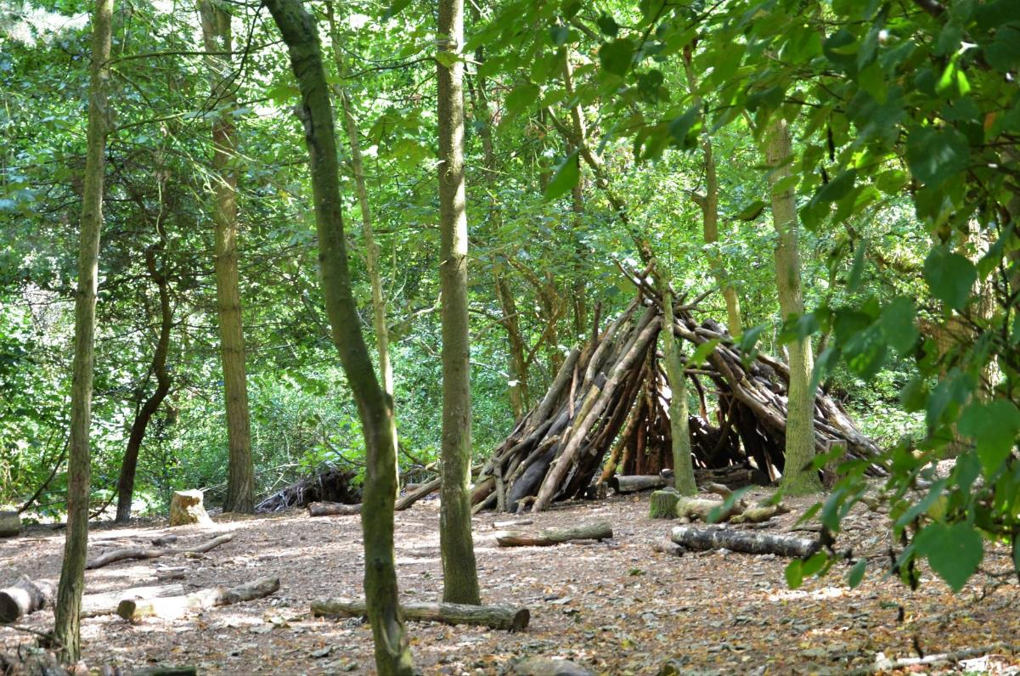
We have seen a real change in the progress and achievement of our children. Their confidence has increased exponentially. This has translated in the classroom into a better attitude for learning and greater confidence in taking part in whole class activities.
Assistant Headteacher - Staffordshire

Slide 14
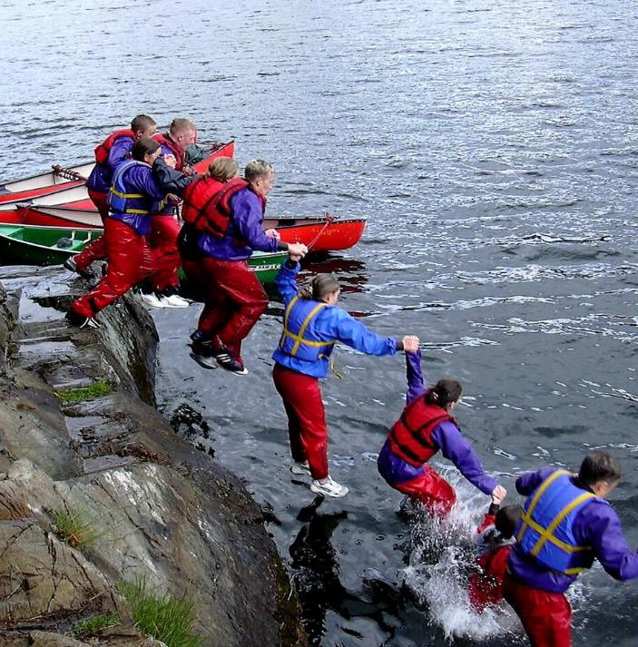
WHY GO TO PLAS GWYNANT
A YOUNG PERSON’S PERSPECTIVE
Try out exciting activities like rock climbing, canoeing and gorge walking
Explore an amazing new place
Make new friends and get to know your classmates even better
It’s an adventure! Go beyond your comfort zone and be open to new experiences
Develop skills, discover passions, boost confidence
Notes:
Teacher perspective:
Everyone who stays at Plas Gywnant gets a warm welcome and the centre soon becomes a home away from home
Develop independence & critical thinking skills
Trying new things and sticking at them
Boost cohesion and sense of belonging
All inclusive – no hidden extras
School and centre staff work as one team to provide the best experience

Slide 15
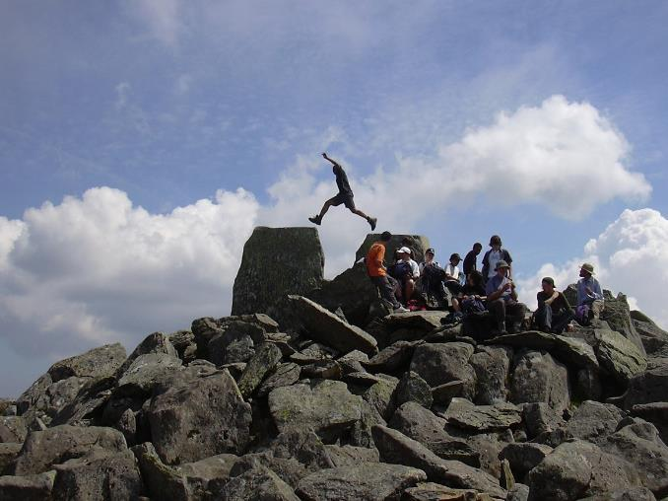
WHY GO TO PLAS GWYNANT
A PARENT’S PERSPECTIVE
Everyone who stays at Plas Gywnant gets a warm welcome and the centre soon becomes a home away from home
Develop independence & critical thinking skills
Trying new things and sticking at them
Boost cohesion and sense of belonging
All inclusive – no hidden extras
School and centre staff work as one team to provide the best experience
Notes:
Young people’s perpective:
Try out exciting activities like rock climbing, canoeing and gorge walking
Explore an amazing new place
Make new friends and get to know your classmates even better
It’s an adventure! Go beyond your comfort zone and be open to new experiences
Develop skills, discover passions, boost confidence

Slide 16
THE EVIDENCE
LEARNING AWAY – BRILLIANT RESIDENTIALS
Compelling 5 year research that shows a residential experience can:
Improve students’ engagement with learning
Support students’ achievement
Improve resilience, self-confidence & wellbeing
Smooth transition

Slide 17
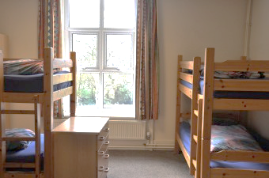
BEDROOMS
We have 54 beds in comfortable dormitories.
Rooms sleep between 2 and 8 pupils
Groups of 40+ have sole use of the centre
All bedding is provided.
Pupils sleep in gender separated areas
Showers and toilet facilities are nearby
Teacher rooms are nearby and centre staff are on hand to provide 24 hour on-site support.

Slide 18
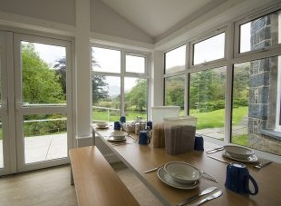
FOOD GLORIOUS FOOD
Home cooked food
We cater for all dietary requirements
Plenty of choice and variety
Example meals:
Lasagne with salad & garlic bread
Vegetable curry with rice & naan
Toad in the hole with mash & veg
Fish fingers & chips
Tuna pasta bake
Main meals are at dinner time with a lighter choice in the afternoon for lunch.

Slide 19
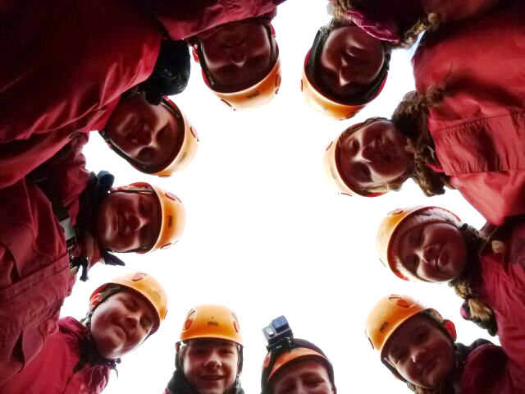
WE CAN’T WAIT TO SEE YOU!
sandwellresidentials.co.uk

