Slide 1
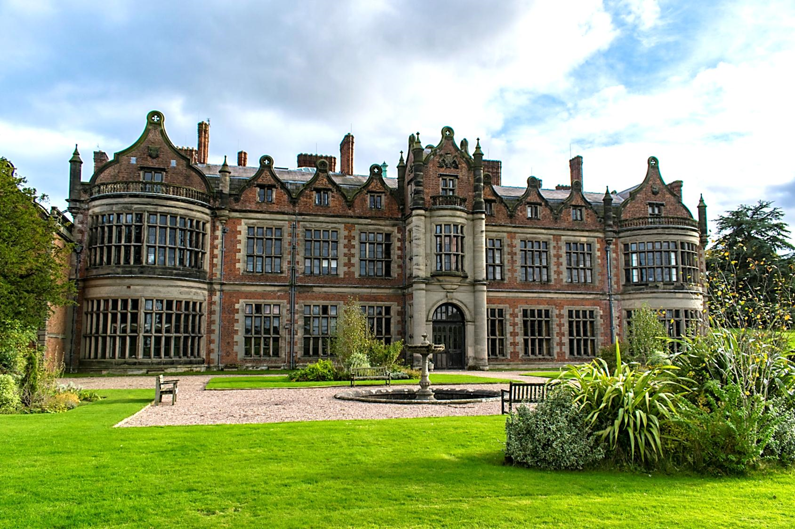
INGESTRE HALL RESIDENTIAL ARTS CENTRE
{enter your date}

Slide 2
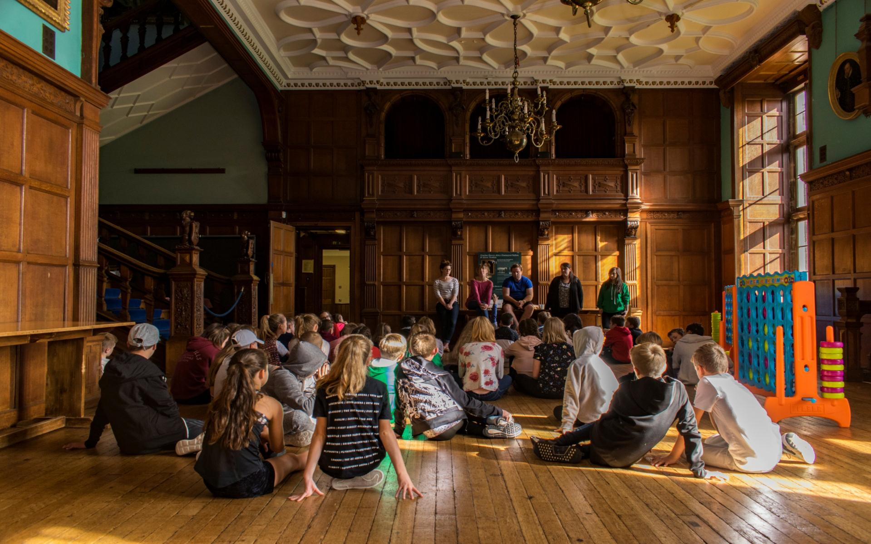
AGENDA
About Sandwell Residential Education Service
Your centre: Ingestre Hall
Activities and learning
Teacher & participant feedback
The benefits of residential experiences
Sleeping & eating
Q & A

Slide 3
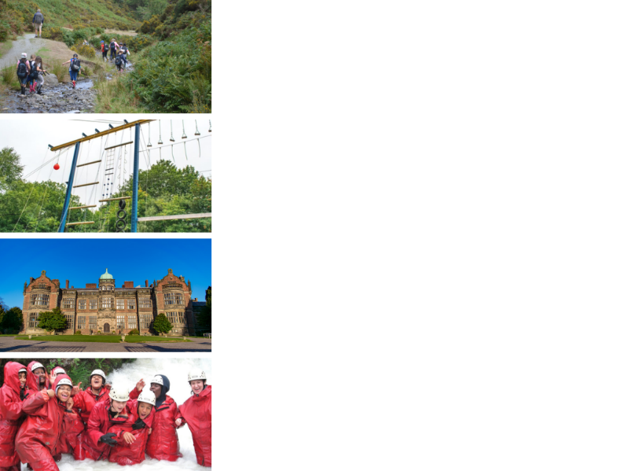
ABOUT SANDWELL RESIDENTIAL SERVICE
4 SUPER VENUES
Edgmond Hall Shropshire
Frank Chapman Centre Wyre Forest
Ingestre Arts Staffordshire
Plas Gwynant Snowdonia
HOME FROM HOME
Small, welcoming centres. Have the place to yourselves!
TAILORED PROGRAMMES
A real learning experience:
The programme is designed with school.
THE HIGHEST STANDARDS
14,000 pax p/a from across the UK

Slide 4
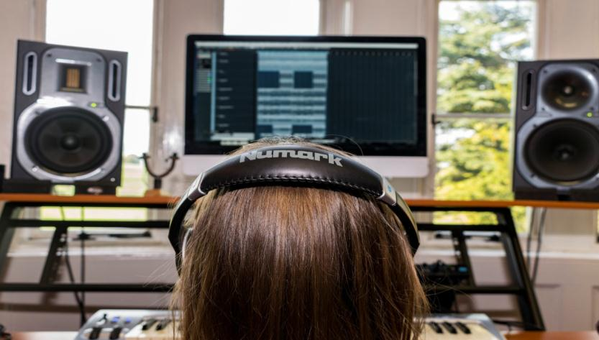
INGESTRE HALL: CENTRE FACTS
Location
A 400 year old Jacobean mansion creating a dramatic backdrop for creative & expressive arts.
Ingestre, Staffordshire, ST18 0RF
Outside
26 acres of landscaped gardens. Plenty of safe space to play.
Inside
Professionally equipped studios, including recording studio, live performance space and animation suites.
90 single beds
Dorms of 4 to 11
Groups of 50+ have sole occupancy

Slide 5
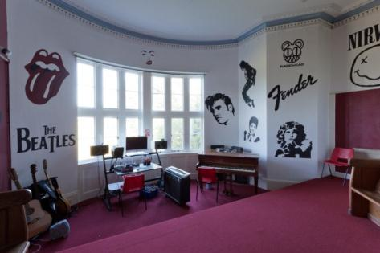
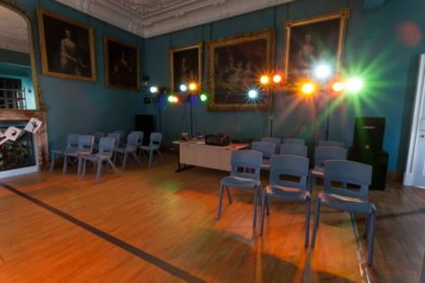
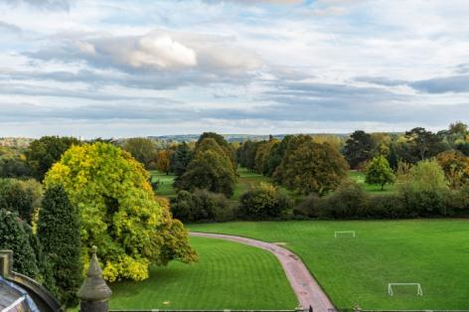
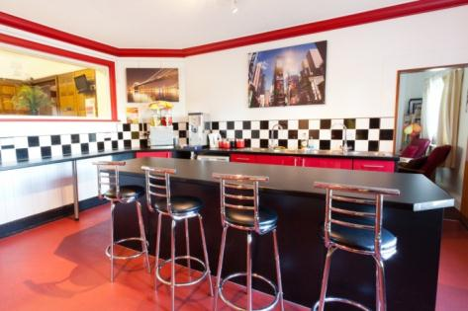
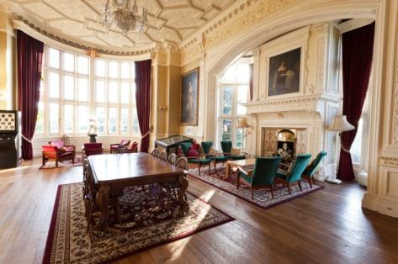
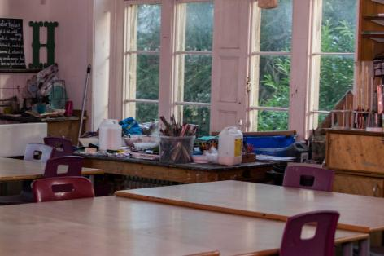
INGESTRE HALL
Notes:
We also have virtual tours which are available on the website

Slide 6
Notes:
Place: the more you immerse a young person – the more memorable it is, the more impactful the experience

Slide 8
Notes:
Lots of space to play

Slide 9
ACTIVITIES
Activities at Ingestre are all about creating something original.
We give people the time and space to imagine, explore a topic, try things out, and share what they’ve done. It’s not just for the “arty” people!
Activities include:
Drama
Art
Dance
Music
Film making
Animation
Photography
Creativity takes courage…..
…. but it’s a huge amount of fun!
Notes:
Place is important. So to are the activities – the things they do.
Creating something original based on a topic / stimulus:

Slide 10
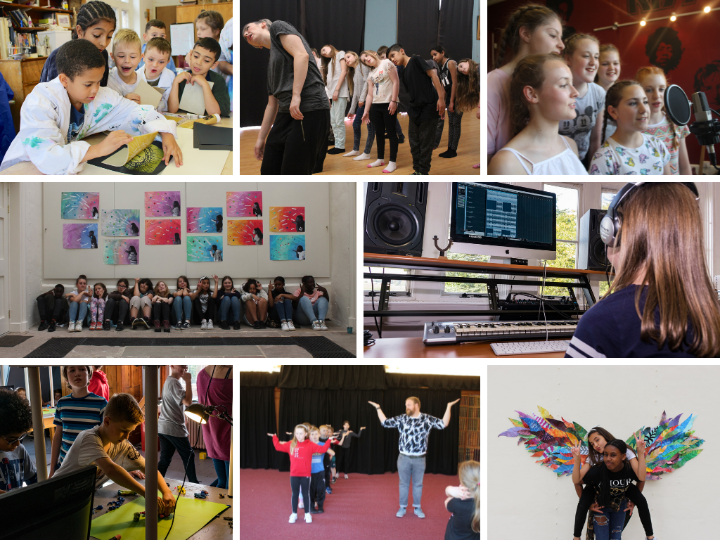

Slide 11
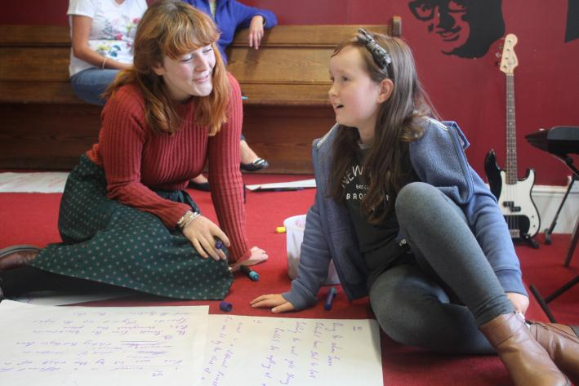
LEARNING
Whether it’s delivering high quality arts activities or simply learning through staying away from home and having fun, the Ingestre team have the soft skills to help every young person achieve more than they ever expected.
We are specialists in residential experiences, and know how valuable it can be.
Tailored Programmes
Every visit is unique. The team work with school and the pupils to shape an exciting, fun, and valuable visit to Ingestre.
Group sizes are 15 students to 1 Ingestre tutor supported by school staff.
Notes:
People – helping young people. Often quite anxious. Express themselves.

Slide 12
We have seen a real change in the progress and achievement of our children. Their confidence has increased exponentially. This has translated in the classroom into a better attitude for learning and greater confidence in taking part in whole class activities.
Assistant Headteacher - Staffordshire

Slide 13
To watch my students transform before my eyes into a new version of themselves - that was amazing!
Assistant Headteacher - Sandwell

Slide 14
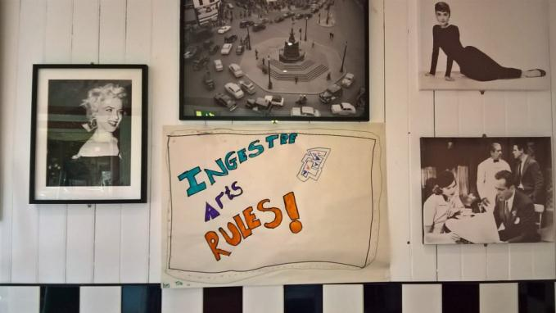
WHY GO TO INGESTRE HALL?
Try out exciting activities like animation, recording music, creating artwork such as pictures and sculptures, or creating a dance
Explore an amazing new place
Make new friends and get to know your classmates even better
Be adventurous: Go beyond your comfort zone and be open to new experiences.
Develop skills, discover passions, boost confidence
Notes:
Develop independence & critical thinking skills
Try new things and stick at them
Boost cohesion and sense of belonging
Professionally equipped studios
All inclusive – no hidden extras
School & centre staff work as one team to provide the best experience.
A warm welcome awaits – the centre soon becomes a home away from home.

Slide 15
THE EVIDENCE
“LEARNING AWAY” – BRILLIANT RESIDENTIALS
Learning Away conducted independent research over 5 years. Their findings show how a residential experience can:
Improve students’ engagement with learning
Support students’ achievement
Improve resilience, self-confidence & wellbeing
Smooth transition
www.learningaway.org.uk

Slide 16
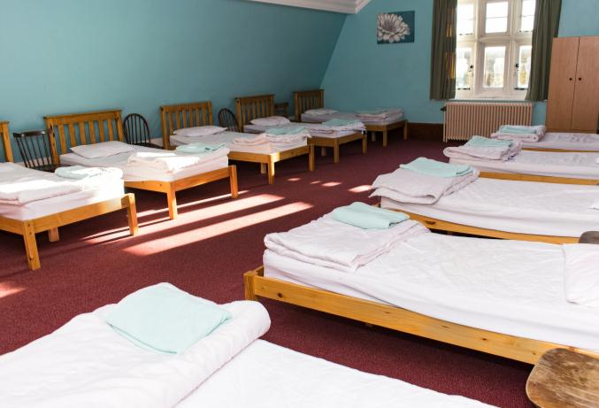
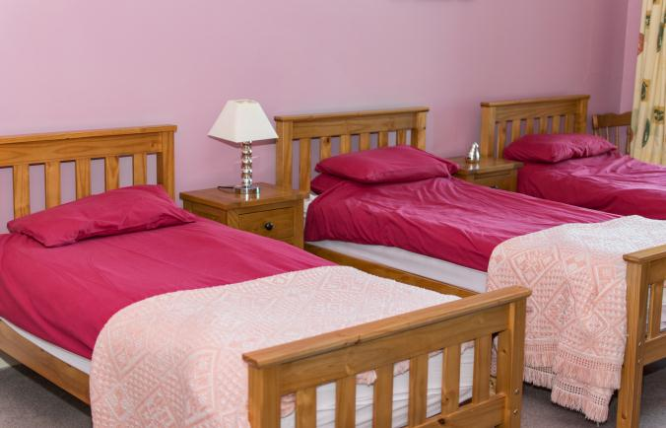
BEDROOMS
We have 90 single beds in comfortable dormitories.
Rooms sleep between 4 and 11 pupils
Groups of 50+ have sole use of the centre
All bedding is provided.
Pupils sleep in gender separated areas
Showers and toilet facilities are nearby
Teacher rooms are nearby and there is 24 hour on-site support from us.

Slide 17
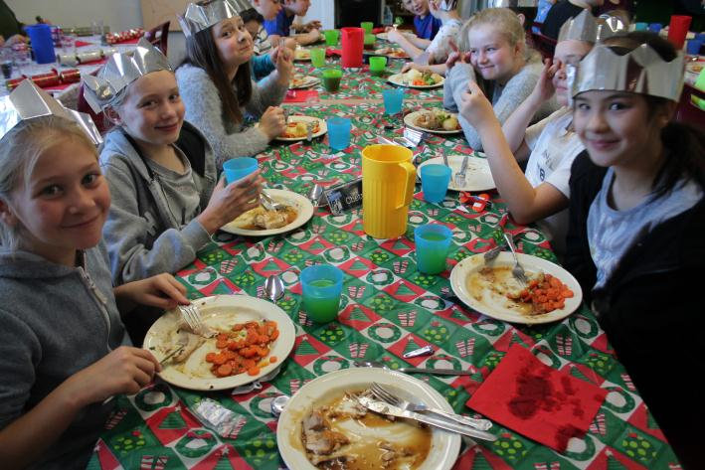
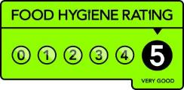
FOOD GLORIOUS FOOD
Home cooked food
We cater for all dietary requirements
Plenty of choice and variety
Example meals:
Pasta Bolognese & garlic bread
Fish fingers, chips & beans
Roast chicken, mash, stuffing & veg
Jacket potatoes with various toppings
Veggie curry, rice & naan

Slide 18
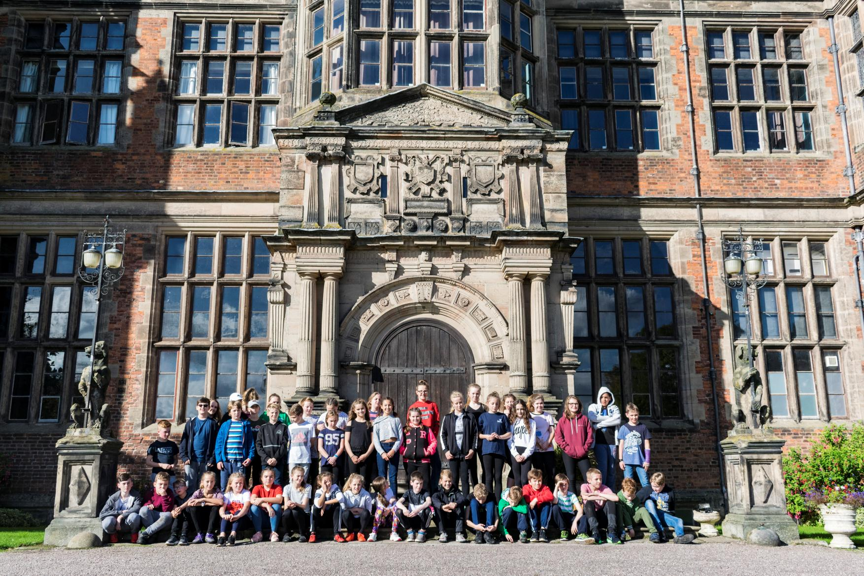
WE CAN’T WAIT TO SEE YOU!
sandwellresidentials.co.uk

Slide 19
WHY GO TO INGESTRE HALL?
A PARENTS’ PERSPECTIVE
Develop independence & critical thinking skills
Try new things and stick at them
Boost cohesion and sense of belonging
Professionally equipped studios
All inclusive – no hidden extras
School & centre staff work as one team to provide the best experience.
A warm welcome awaits – the centre soon becomes a home away from home.

