Slide 1
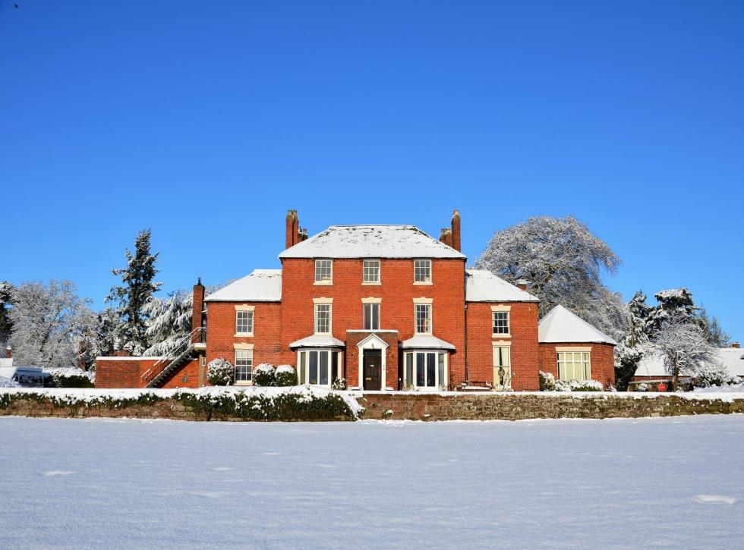
EDGMOND HALL CENTRE FOR OUTDOOR LEARNING
2 – 4 March 2020

Slide 2
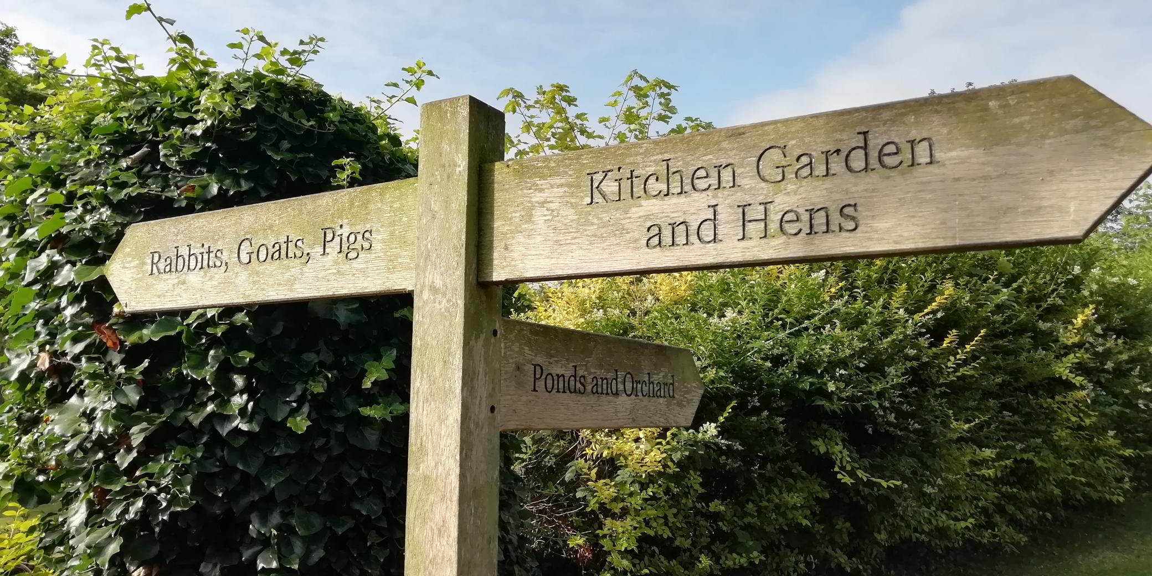
AGENDA
About Sandwell Residential Education Service
Your centre: Edgmond Hall
Activities and learning
Teacher & participant feedback
The benefits of residential experiences
Sleeping & eating
Q & A

Slide 3
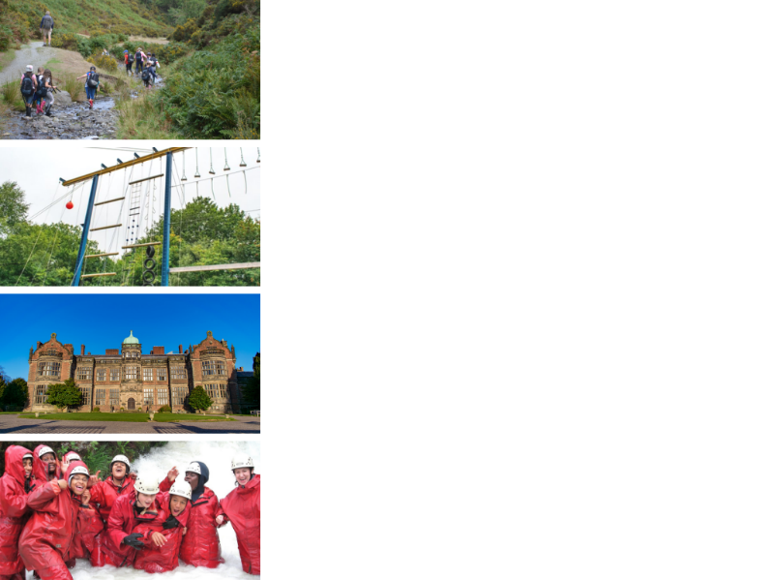
ABOUT SANDWELL RESIDENTIAL SERVICE
4 SUPER VENUES
Edgmond Hall Shropshire
Frank Chapman Centre Wyre Forest
Ingestre Arts Staffordshire
Plas Gwynant Snowdonia
HOME FROM HOME
Small, welcoming centres. Have the place to yourselves!
TAILORED PROGRAMMES
A real learning experience:
The programme is designed with school.
THE HIGHEST STANDARDS
14,000 pax p/a from across the UK

Slide 4
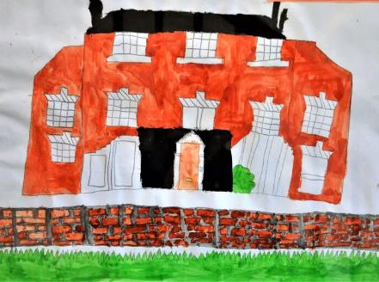
EDGMOND HALL: CENTRE FACTS
Location
An attractive Georgian farm set in rural Shropshire, near to Newport.
Edgmond, Newport, Shropshire. TF10 8JY
Outside
43 acres of gardens, woodland and fields with small animals on site. Plenty of safe space to play and explore.
Inside
Spacious rooms for creative experiences, team games, fencing, and recreation.
60 beds
Dorms of 6 to 16
Groups of 36+ have sole occupancy

Slide 5
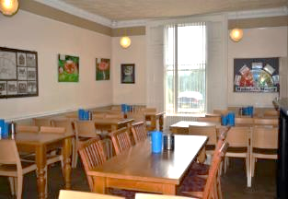
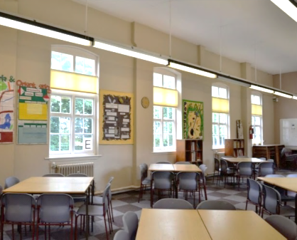
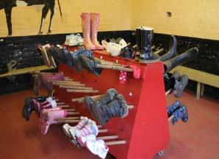
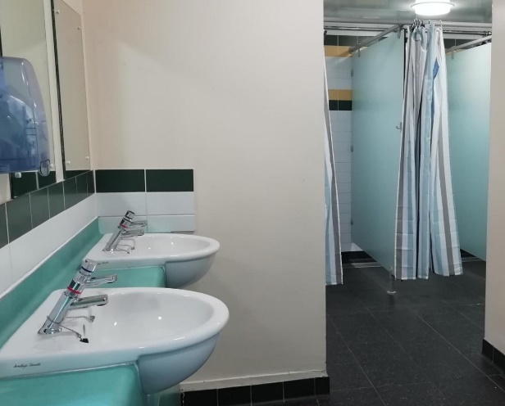
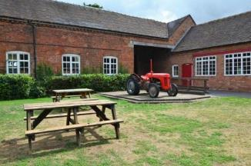
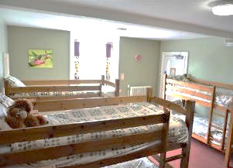
EDGMOND HALL

Slide 6
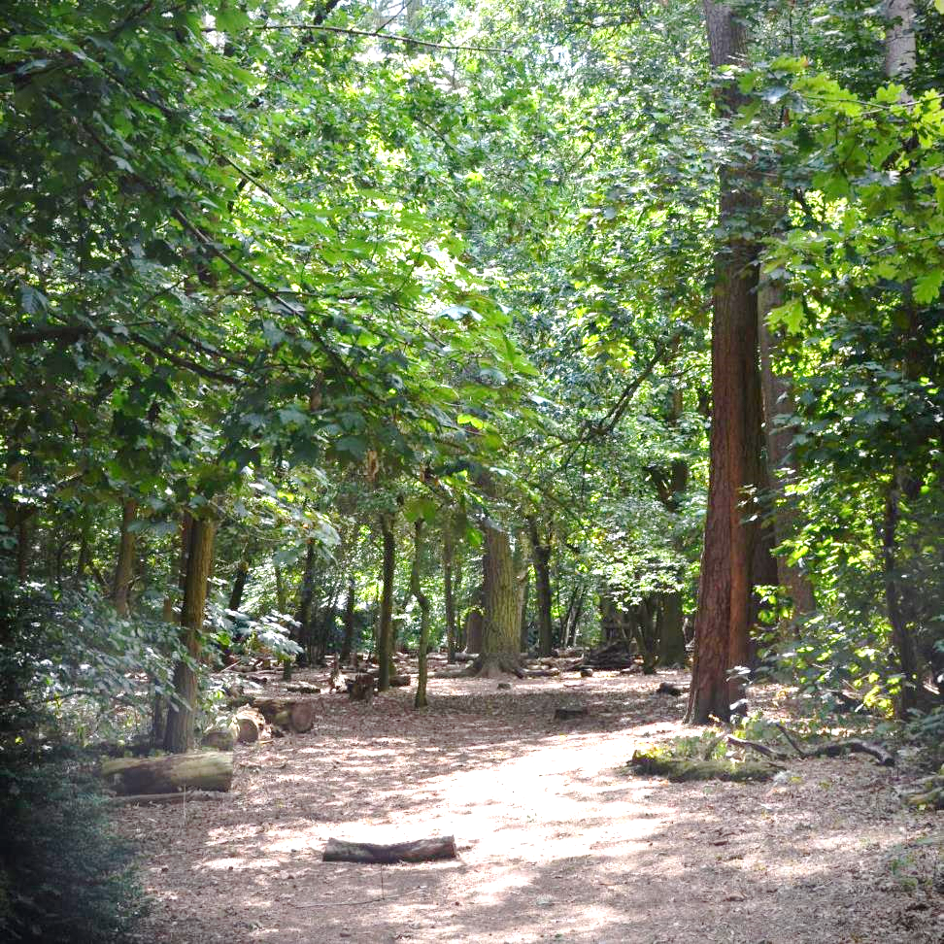
With magical woodland…

Slide 7
… space to try new things

Slide 8
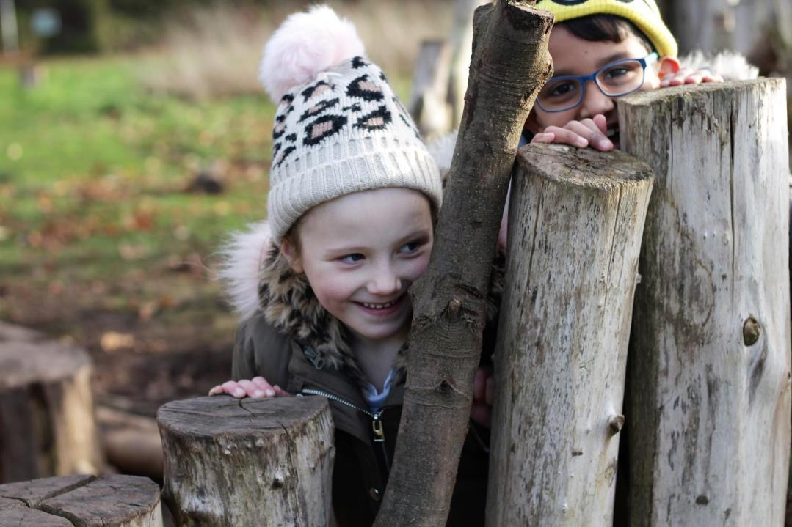
and time to play..

Slide 9
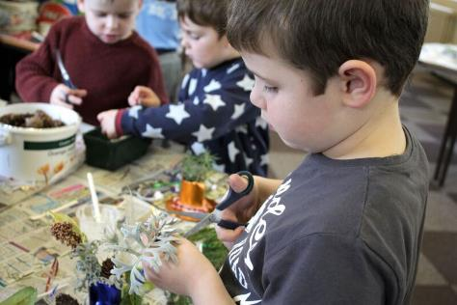
ACTIVITIES
Activities at Edgmond Hall are all about adventure, exploration, and exciting challenge.
We make full use of the beautiful woodland and gardens, as well as taking students off site to nearby attractions.
Activities include:
Archery
Fencing
Shelter building
Nature trails
Meeting our animals
Night walk and campfires
Orienteering
Team building and problem solving
We include time to play; this is a great chance for relationships develop.

Slide 10
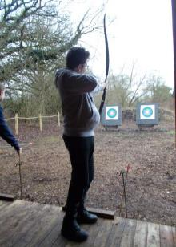
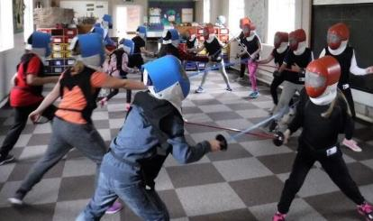
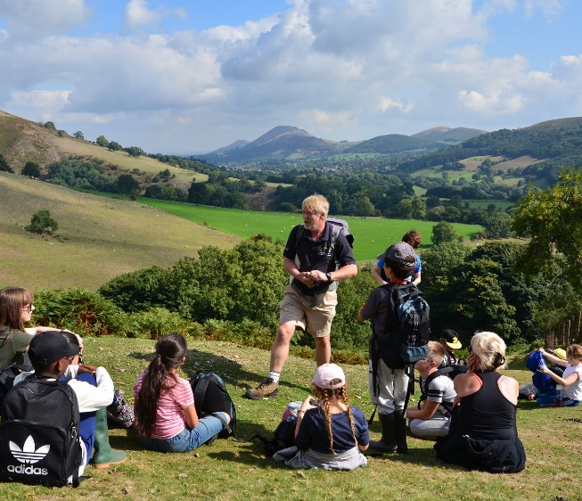
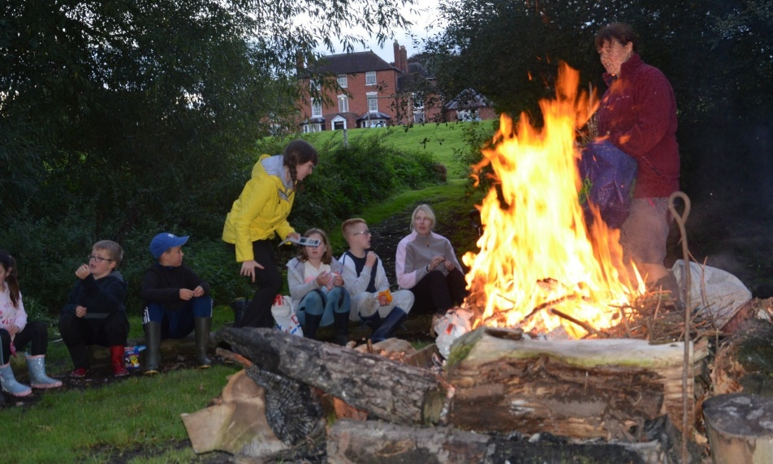
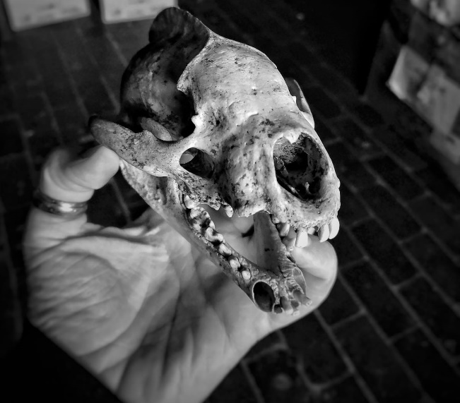
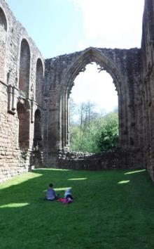
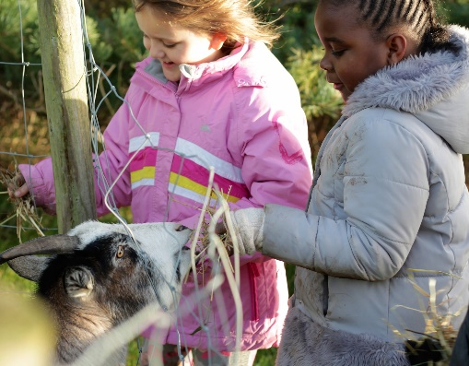
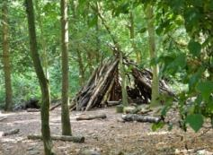
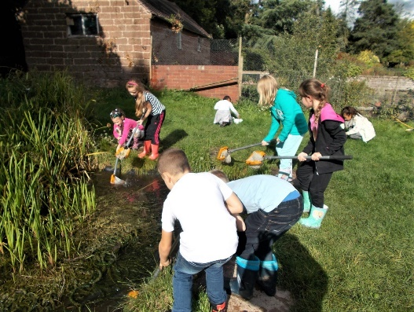

Slide 11
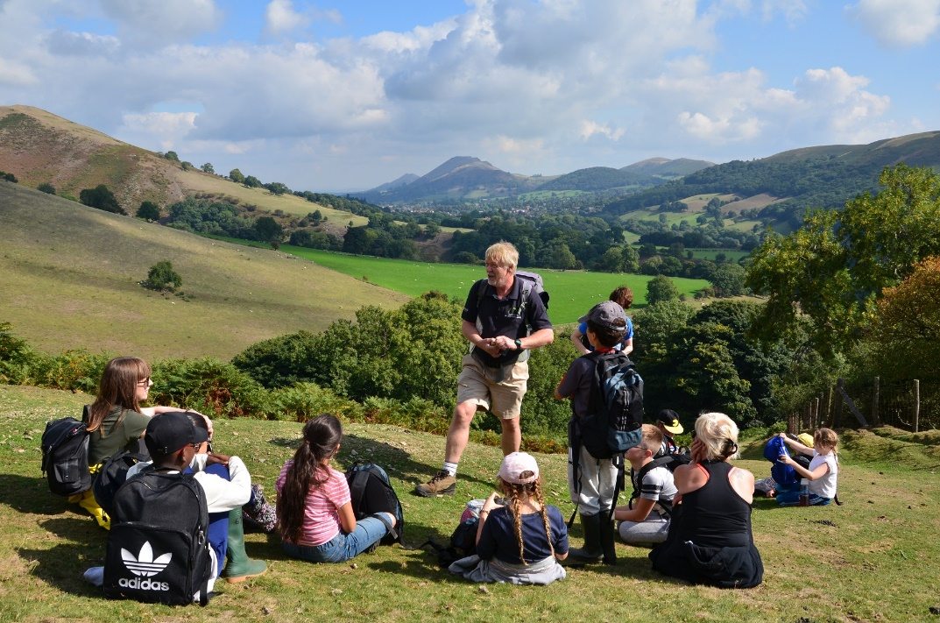
LEARNING
Whether it’s delivering high quality outdoor activities or simply learning through staying away from home and having fun, the Edgmond Hall team have the soft skills to help every young person achieve more than they ever expected.
We are specialists in residential experiences, and know how valuable it can be
Tailored Programmes
Every visit is unique. The team work with school and the pupils to shape an exciting, fun, and valuable visit to Edgmond Hall.
Our team work in partnership with teachers to deliver fun, and memorable experiences

Slide 12
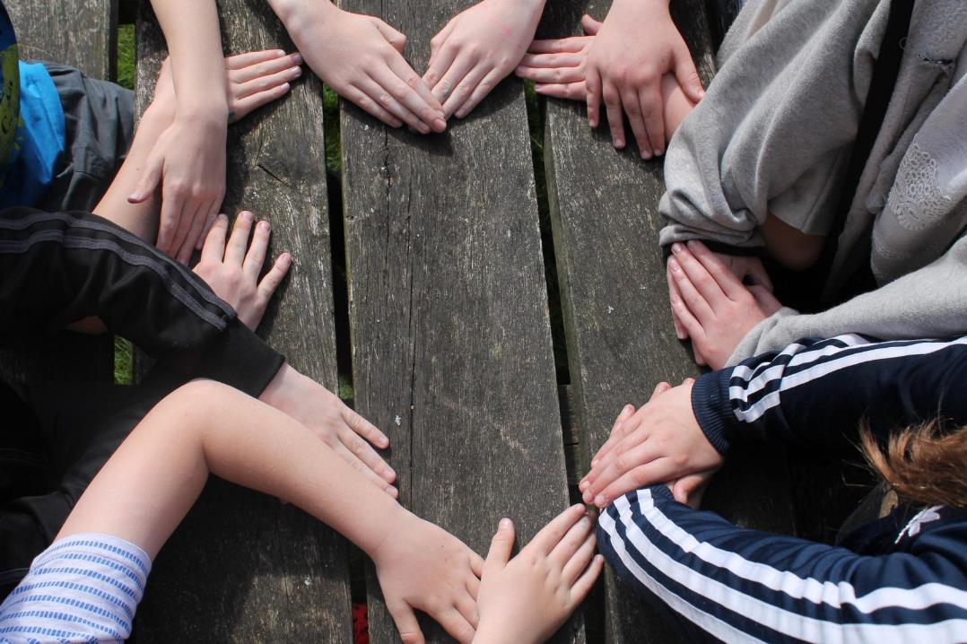
To watch my students transform before my eyes into a new version of themselves - that was amazing!
Assistant Headteacher - Sandwell

Slide 13
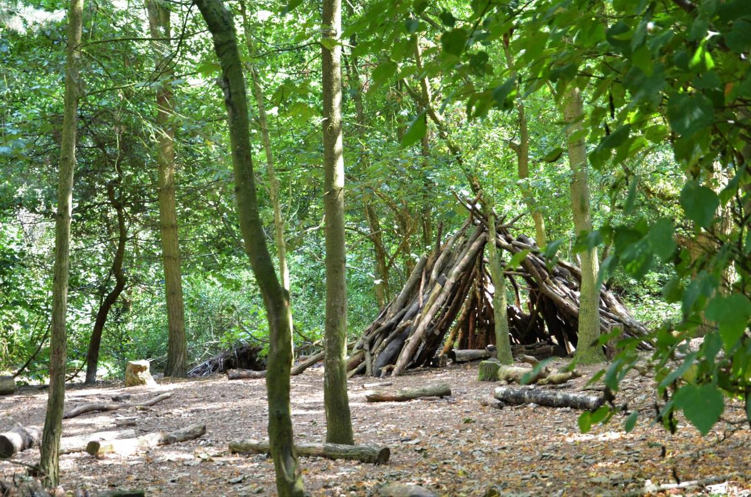
We have seen a real change in the progress and achievement of our children. Their confidence has increased exponentially. This has translated in the classroom into a better attitude for learning and greater confidence in taking part in whole class activities.
Assistant Headteacher - Staffordshire

Slide 14
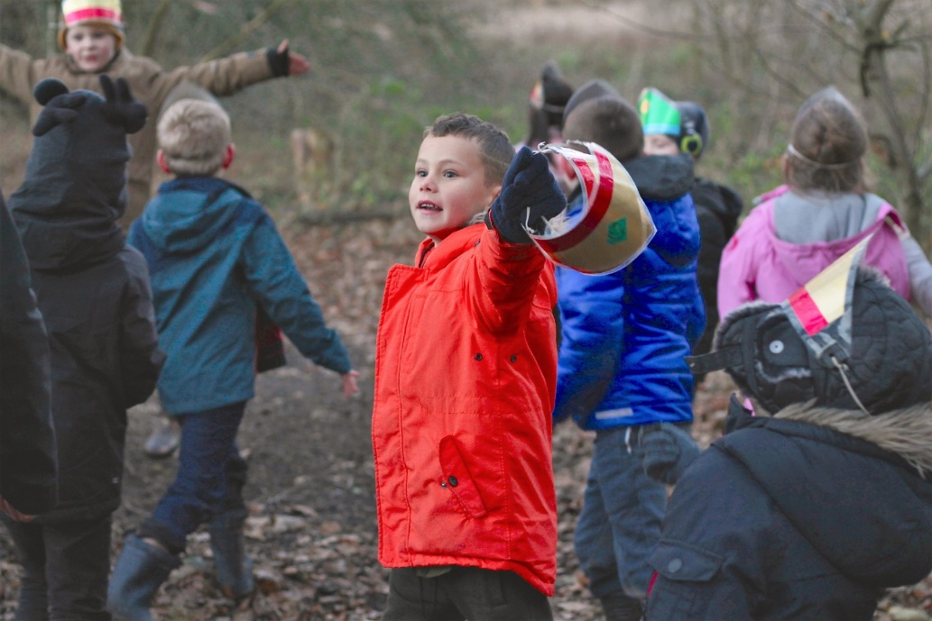
WHY GO TO EDGMOND HALL?
A YOUNG PERSON’S PERSPECTIVE
Try out exciting activities like archery, orienteering and fencing.
Explore an amazing new place
Make new friends and get to know your classmates even better
It’s an adventure! Go beyond your comfort zone and be open to new experiences
Develop skills, discover passions, boost confidence

Slide 15
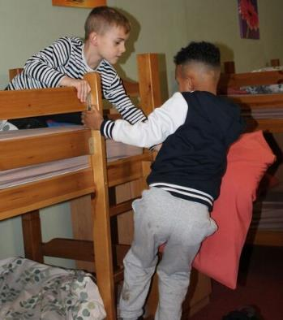
WHY GO TO EDGMOND HALL?
A PARENT’S PERSPECTIVE
Everyone who stays at Edgmond Hall gets a warm welcome and the centre soon becomes a home away from home
Develop independence & critical thinking skills
Trying new things and sticking at them
Boost cohesion and sense of belonging
All inclusive – no hidden extras
School and centre staff work as one team to provide the best experience

Slide 16
THE EVIDENCE
LEARNING AWAY – BRILLIANT RESIDENTIALS
Compelling 5 year research that shows a residential experience can:
Improve students’ engagement with learning
Support students’ achievement
Improve resilience, self-confidence & wellbeing
Smooth transition
www.learningaway.org.uk

Slide 17
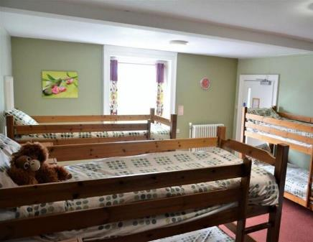
BEDROOMS
We have 60 beds in comfortable dormitories
Rooms sleep between 6 and 16 pupils
Groups of 36+ have sole use of the centre
All bedding is provided.
Pupils sleep in gender separated areas
Showers and toilet facilities are nearby
Teacher rooms are nearby and centre staff are on hand to provide 24 hour on-site support.

Slide 18
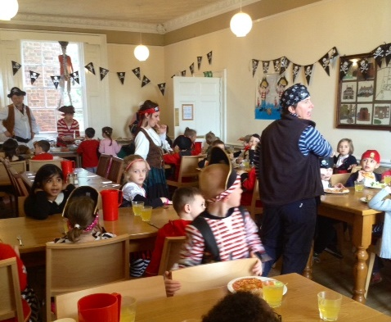
FOOD GLORIOUS FOOD
Home cooked food
We cater for all dietary requirements
Plenty of choice and variety
Example meals:
Lasagne with salad & garlic bread
Vegetable curry with rice & naan
Toad in the hole with mash & veg
Fish fingers & chips
Tuna pasta bake

Slide 19
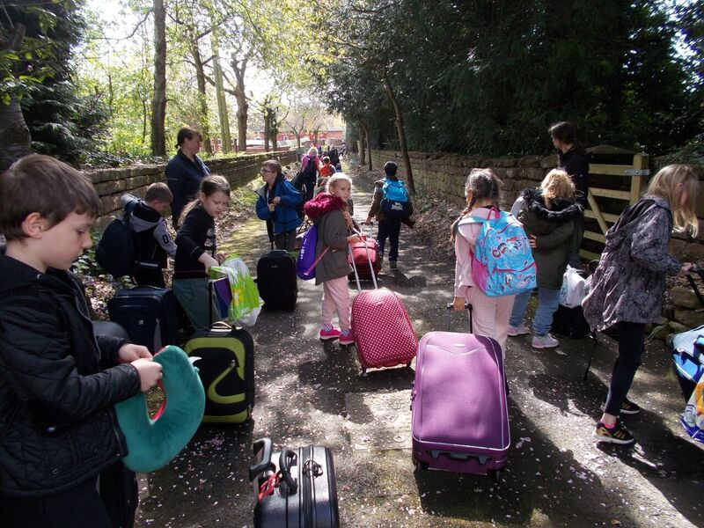
WE CAN’T WAIT TO SEE YOU!
sandwellresidentials.co.uk

