Slide 1
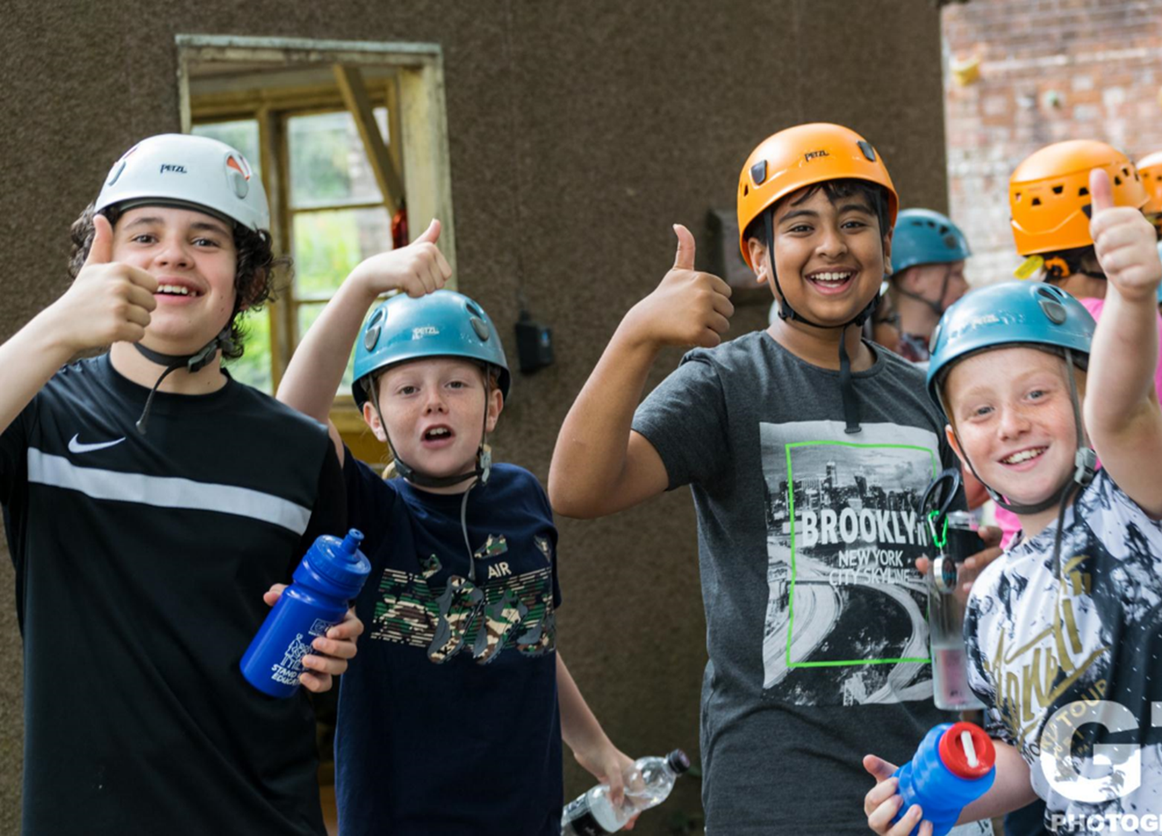
Frank Chapman Outdoor Education Centre
6 – 8 June 2022

Slide 2
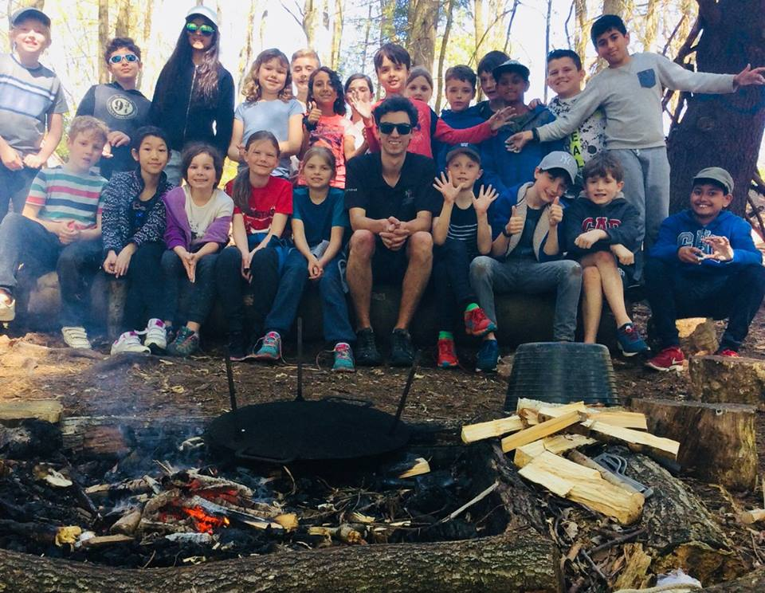
AGENDA
About Sandwell Residential Education Service
Your centre: Frank Chapman
Activities
Feedback
Sleeping & eating
Q & A

Slide 3
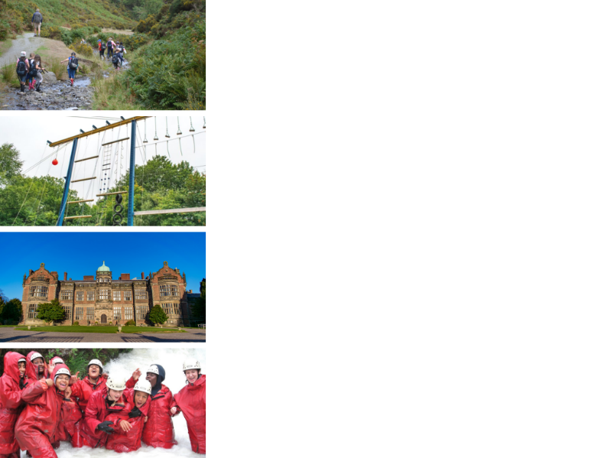
ABOUT SANDWELL RESIDENTIAL SERVICE
4 SUPER VENUES
Edgmond Hall Shropshire
Frank Chapman Centre Wyre Forest
Ingestre Arts Staffordshire
Plas Gwynant Snowdonia
HOME FROM HOME
Small, welcoming centres. Have the place to yourselves!
TAILORED PROGRAMMES
A real learning experience:
The programme is designed with school.
THE HIGHEST STANDARDS
14,000 pax p/a from across the UK

Slide 4
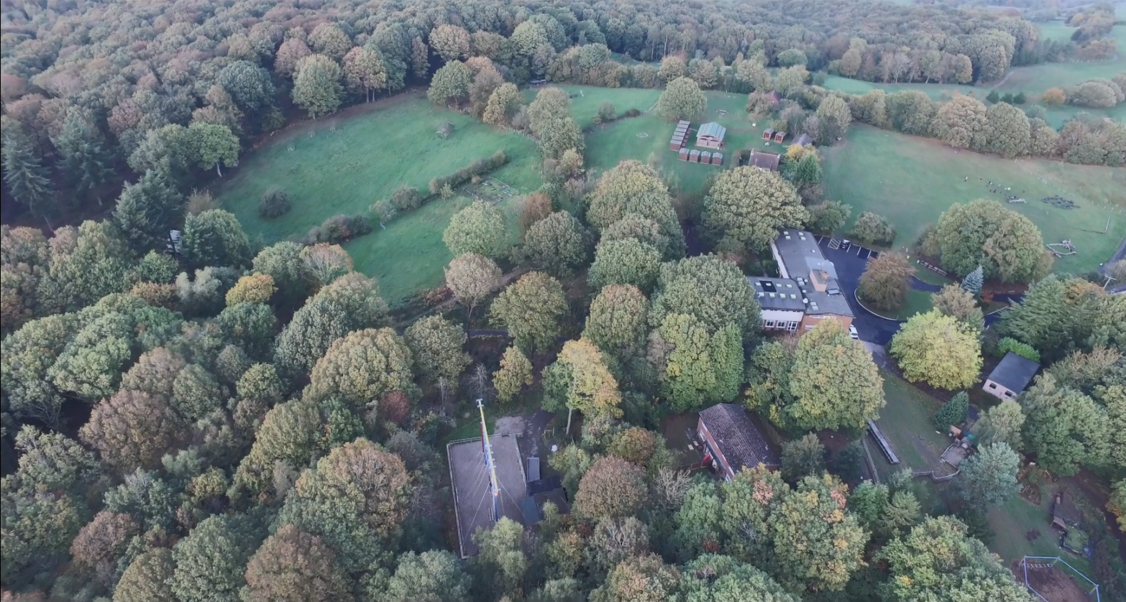
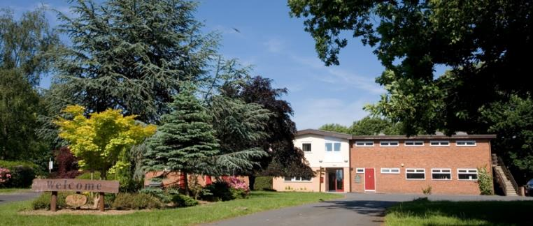
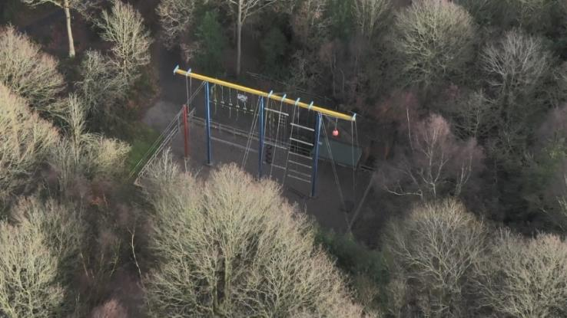
Notes:
What the young people see is…

Slide 5
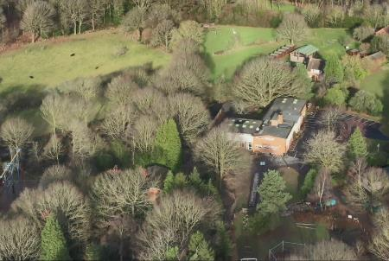
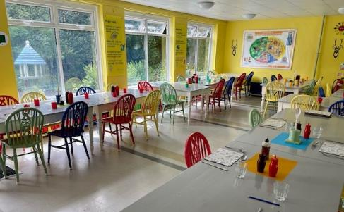
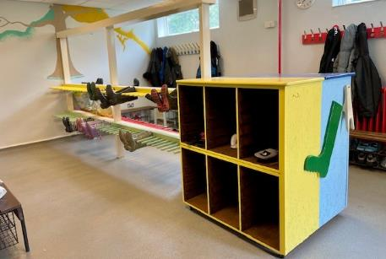
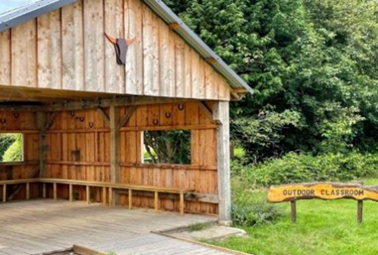
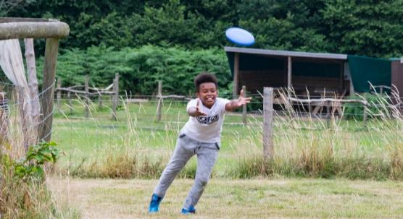
FRANK CHAPMAN: AROUND THE SITE
Notes:
90 private acres, all specialist kit is provided, outdoor classroom, covered bushcraft available, indoor classrooms available.

Slide 6
Notes:
Tutors and learning

Slide 7
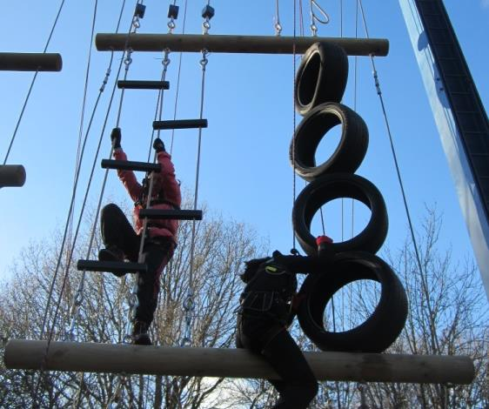
ACTIVITIES
Activities at the centre are about adventure, challenge, exploration, discovery and learning through experience.
We make full use of the beautiful 90 acre ancient woodland
Activities can include:
High ropes course
Climbing wall/abseil
Bushcraft skills and shelter building
Night walk and campfires
Orienteering / Geo caching
Underground mine
Archery
Mountain biking
Team confidence building games
We include structured free time; this is a great chance for relationships develop.
Notes:
Activities tailored to suit the children and the conditions.

Slide 8
Notes:
Important time for relationships to develop

Slide 9
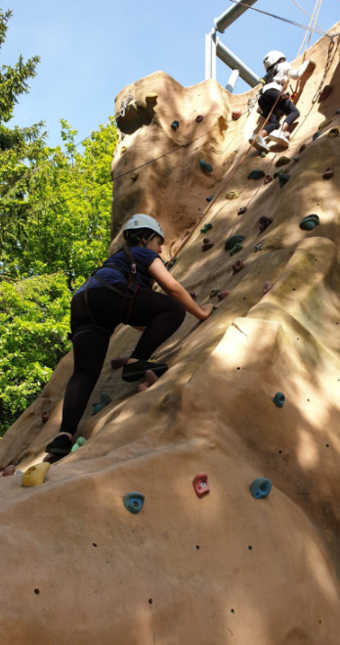
Notes:
Important time for relationships to develop

Slide 10
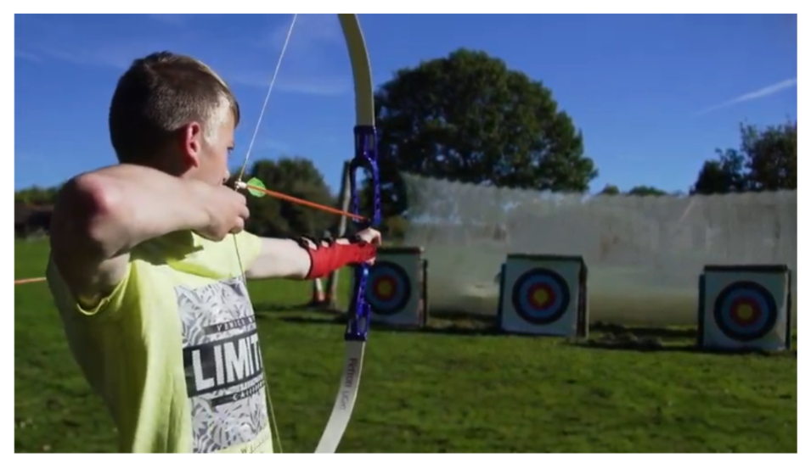
Notes:
What the young people see is…

Slide 11
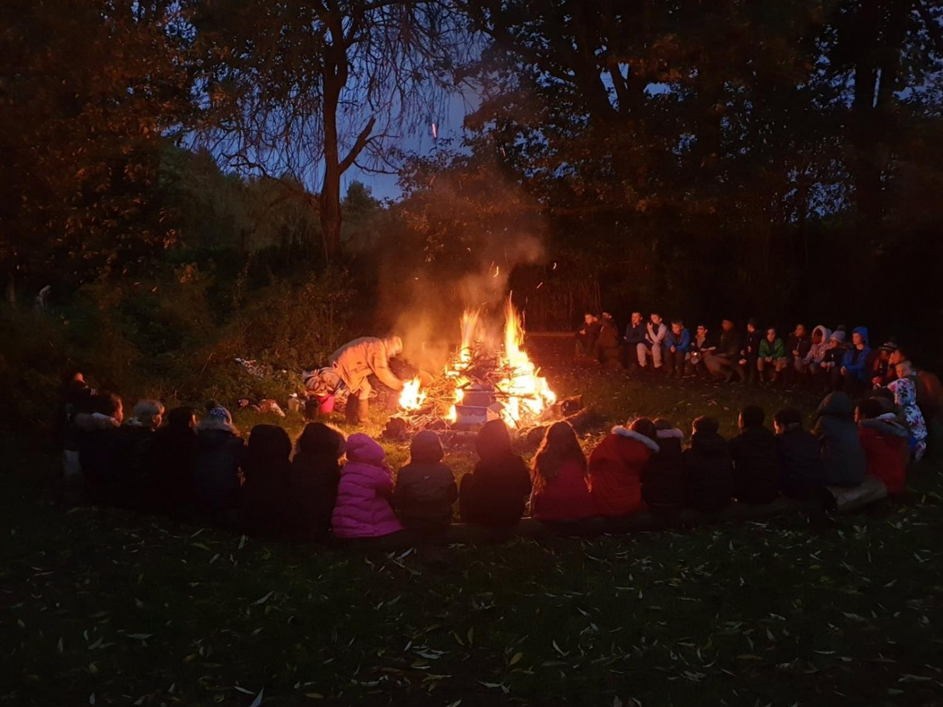
Notes:
What the young people see is…

Slide 12
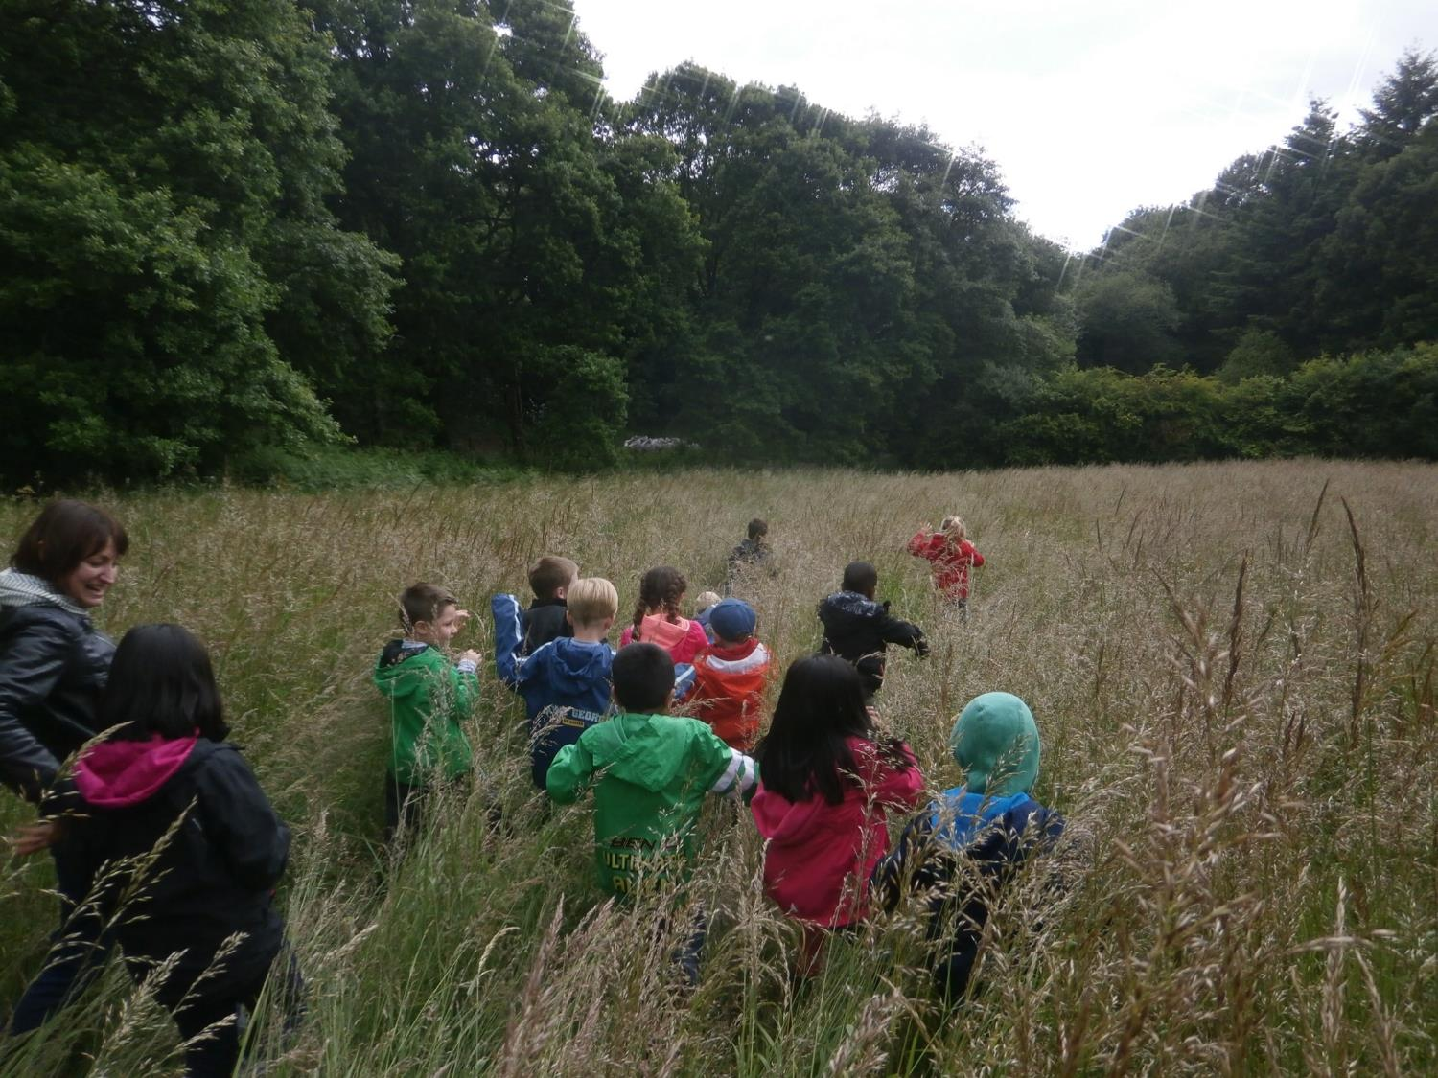
Notes:
What the young people see is…

Slide 13
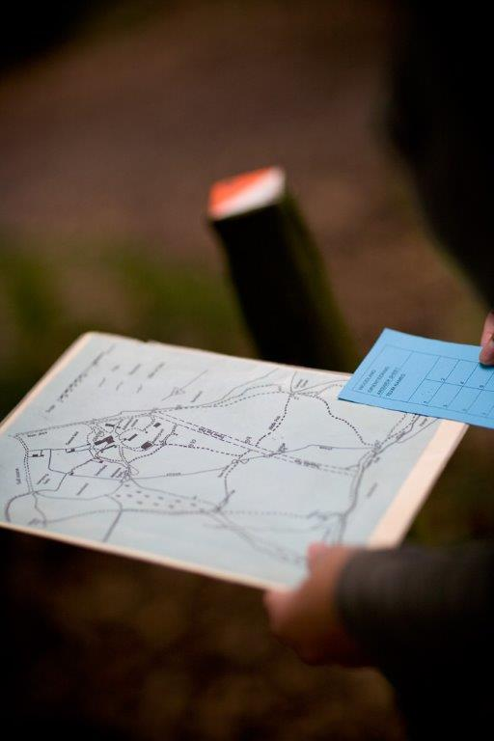
Notes:
What the young people see is…

Slide 14
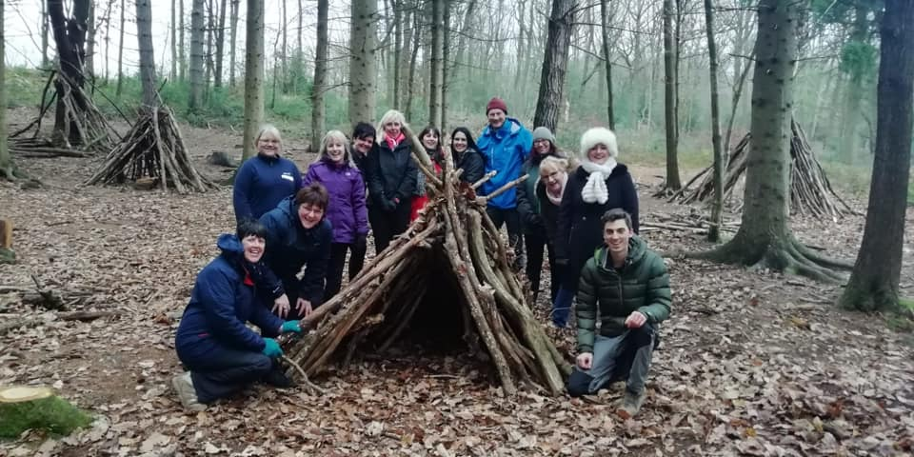
Notes:
Important time for relationships to develop

Slide 15
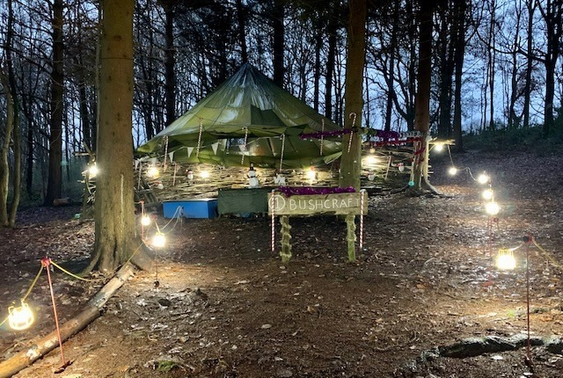
Notes:
Important time for relationships to develop

Slide 16
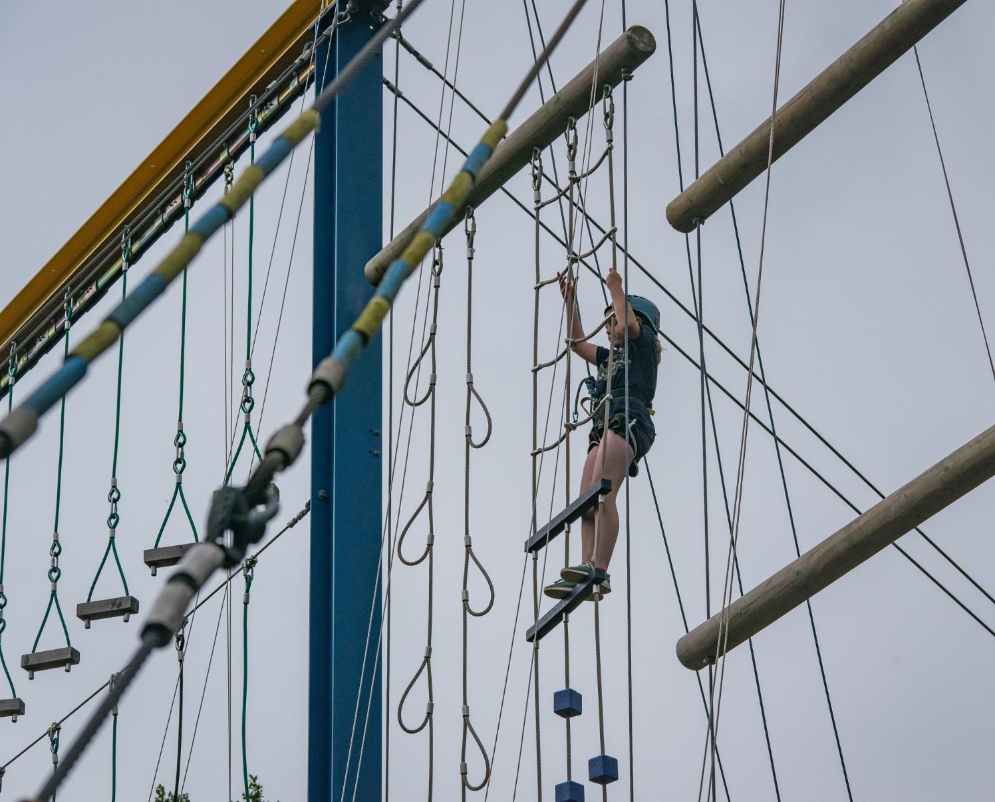
Notes:
What the young people see is…

Slide 17
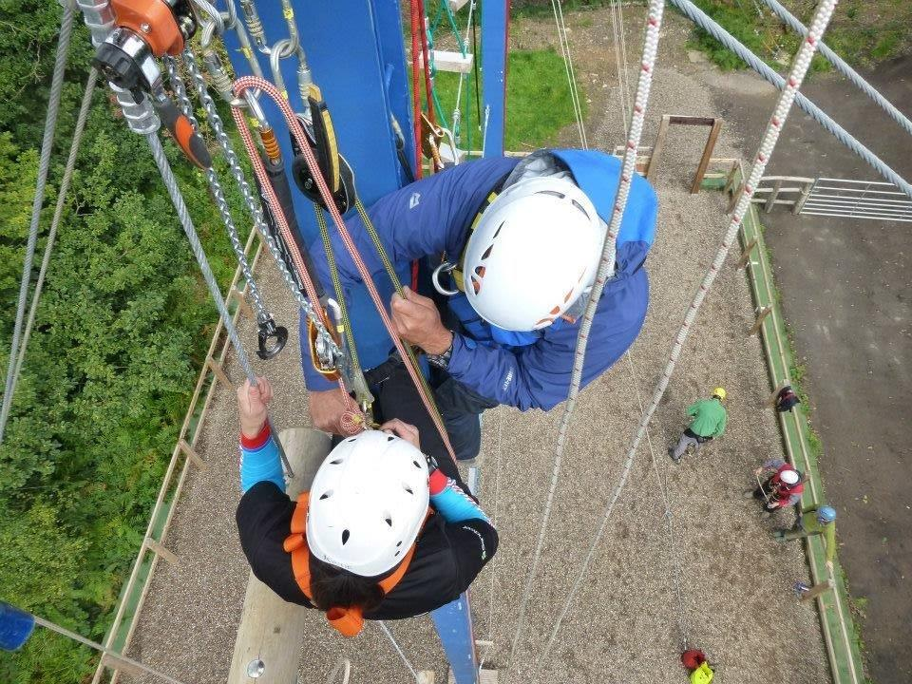
Notes:
Important time for relationships to develop

Slide 18
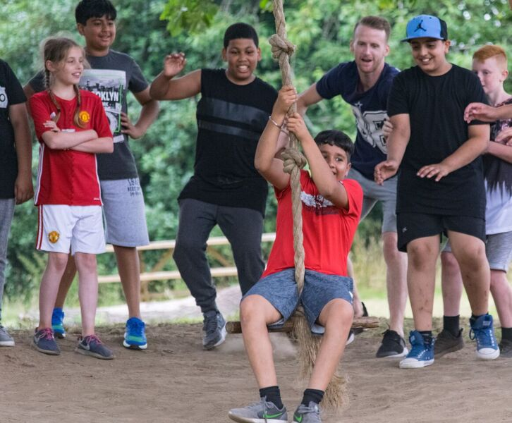
Notes:
Important time for relationships to develop

Slide 19
SLEEPING
We have 60 beds in comfortable dormitories
Rooms sleep between 6 and 16 pupils
Groups of 36+ have sole use of the centre
All bedding is provided.
Pupils sleep in gender separated areas
Showers and toilet facilities are nearby
Teacher rooms are nearby and centre staff are on hand to provide 24 hour on-site support.

Slide 20
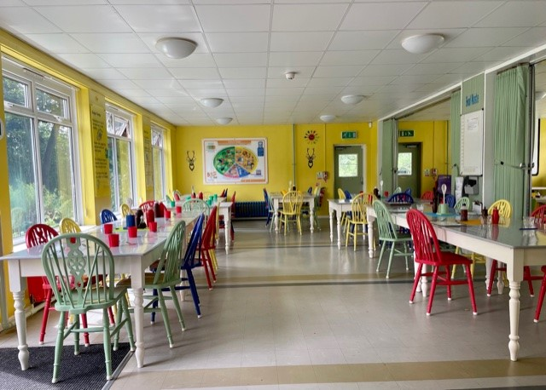
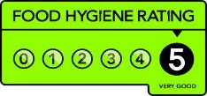
FOOD GLORIOUS FOOD
Home cooked food and cakes!
We cater for all dietary requirements
Plenty of choice and variety
Example meals:
Chicken tikka curry with rice & naan
Sausage with mash & veg
Fish fingers & chips
Meatballs / Bolognaise pasta
Jacket potato option with salad

Slide 21
WHY GO TO FRANK CHAPMAN?
A YOUNG PERSON’S PERSPECTIVE
Try out exciting activities like archery, orienteering and fencing.
Explore an amazing new place
Make new friends and get to know your classmates even better
It’s an adventure! Go beyond your comfort zone and be open to new experiences
Develop skills, discover passions, boost confidence

Slide 22
WE CAN’T WAIT TO SEE YOU!
sandwellresidentials.co.uk

